Slide 1



GCCAP 19
Grant Roll-Out
Friday, July 17, 2026
9:00 am – 10:00 am
Loretta McQueen, Coordinator
Office of College and Career Academies

Slide 2
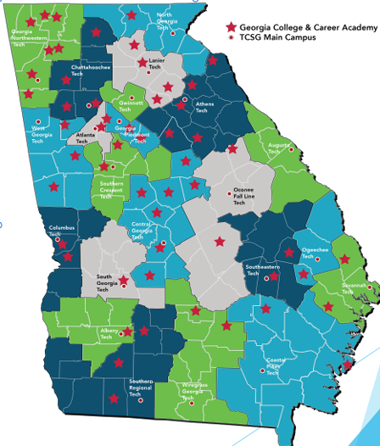
Project Overview
Over $174.5M awarded/invested through legislation
60 total awarded Academies
$3M total available for Construction/Renovation
$100K available in Cash/Services for start-up operations

Slide 3
Solicitation for Grant Application (SGA) Details
Award Information
1 Grant to be awarded
$3M for Construction/Renovation
$100K for Operations/Services
Eligibility Information
Technical School/School District Partnership
Application Information
Part I: Cost/Budget Proposal
Part II: Technical Programmatic Proposal Narrative
Part III: Detailed information in Support of Part II
Part IV: Additional Documentation and Materials

Slide 4
Solicitation for Grant Application (SGA) Details
GCCA Certification Specifics:
GCCA Certification (SB348) (OCGA 20-4-37) - An accountability measure that partners TCSG & DOE to align towards Performance Contract Renewal, flexibility, and general Academy enhancements.
Certification Assurance – Agree to participate in GCCA certification processes and site visit reviews
Other Assurances:
GCCAN Participation (i.e. CEO meetings & Board Trainings)
Construction/Renovations must be on government owned/controlled property
CEO position must be separate from building administrator (external)
Marketing Plan – website & co-signeage with postsecondary partner

Slide 5
Solicitation for Grant Application (SGA) Details
Timeline & KEY Dates
Application Open – June 30, 2026
Grant Orientation – July 17, 2026
Grant Submission – September 18, 2026
Applicant Site Visits – September/November 2026
Formal Interviews/Presentations - Week of November 16th, 2026
Award Announcement – December 3, 2026 (TCSG State Board Meeting)
Awardees Next Steps Webinar – January 2027

Slide 6
Solicitation for Grant Application (SGA) Details
Application Portal & Online Submission:
https://tcsg.smapply.io/prog/georgia_college_and_career_academies_project_gccap_-_19/
Each partnership must identify ONE(1) person to manage the online submission
This person will act as the main POC for setting up the application site and serve as the keeper of the portal password and username
The GCCAP 19 Grant Application packet is embedded on the landing page and can be downloaded

Slide 7
Selection Process
Review
Eligibility
Meeting Application Requirements
Team of Readers
Rate Application inside of Portal – one reader per criteria
Local On-site Feedback
Share reader scores/comments
Discuss CCA Partnership Roles & Responsibilities
Local On-site Feedback
Share reader scores/comments
Discuss CCA Partnership Roles & Responsibilities
Presentation Panel
Partnership invited to present as process capstone (location, date TBD)

Slide 8
Funding
2 Components of GCCAP Awards:
Capital Outlay component (for construction and/or renovation)
Finance through 20-year General Obligation bonds
Assets must have useful life of at least 20 years
Current year operating funds component ( for start-up expenses)
Financed through current year state appropriations
Expenditures must serve the public purpose of the appropriation
Projects should be... Ready To Go!
The state certifies that it has a "reasonable expectation" that projects funded will be completed within 3 years.
5% spent of obligated within six months
85% spend within three years
100% spent within five years

Slide 9
Funding
Allowable Funds Usage:
Acquisition of land
Construction of new buildings, renovation of existing buildings
Professional services as design, engineering, commissioning
Initial landscaping
Parking lots
Non-Allowable Funds Usage:
Personal services, Lease payments, Maintenance agreements for copiers or computers, Delectable/disposable items, Moving costs, Decorative items, Repair and Maintenance items, Office supplies, Fuel oil, Termite inspections, Drug tests for employees, Annual fire inspections

Slide 10
Facilities Funding
Allowable Facilities:
Lease Property for CCA
Renovate State-owned property
Build New Building on state-owned property
Renovate school district-owned property
Build new building on school district-owned property
TCSG Facilities:
Brendan Bowen
Assistant Commissioner
Office of Capital Planning and Facilities
bbowen@tcsg.edu | 404.679.2925 (O) | 404.606.2384 (M)
Chang W. Jung
Associate Director of Real Estate and Planning
Office of Capital Planning and Facilities
404.679.1702 | cjung@tcsg.edu | TCSG.ed
Non-Allowable Funds Usage:
Mobile units

Slide 11
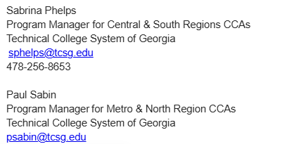
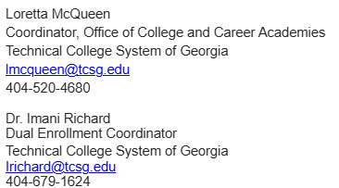


TCSG/OCCA Contacts

